Slide 1

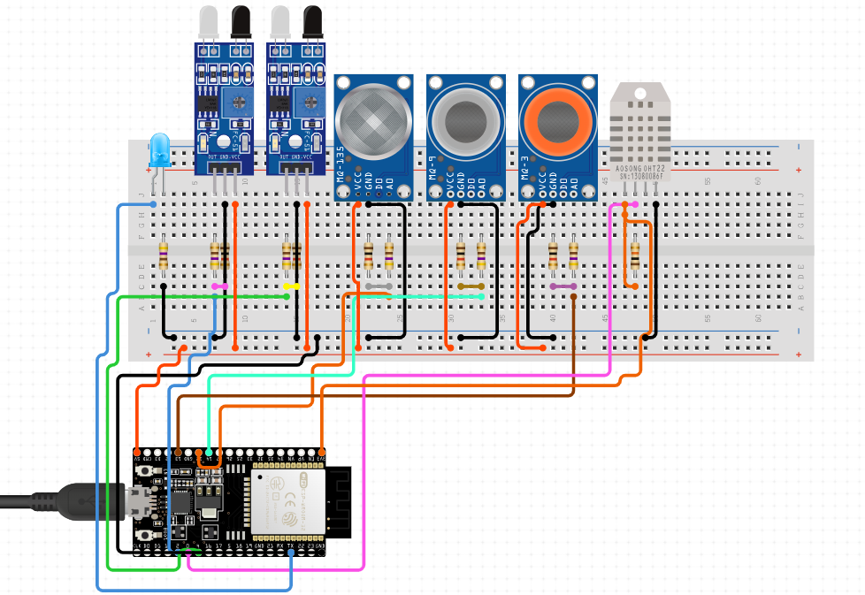
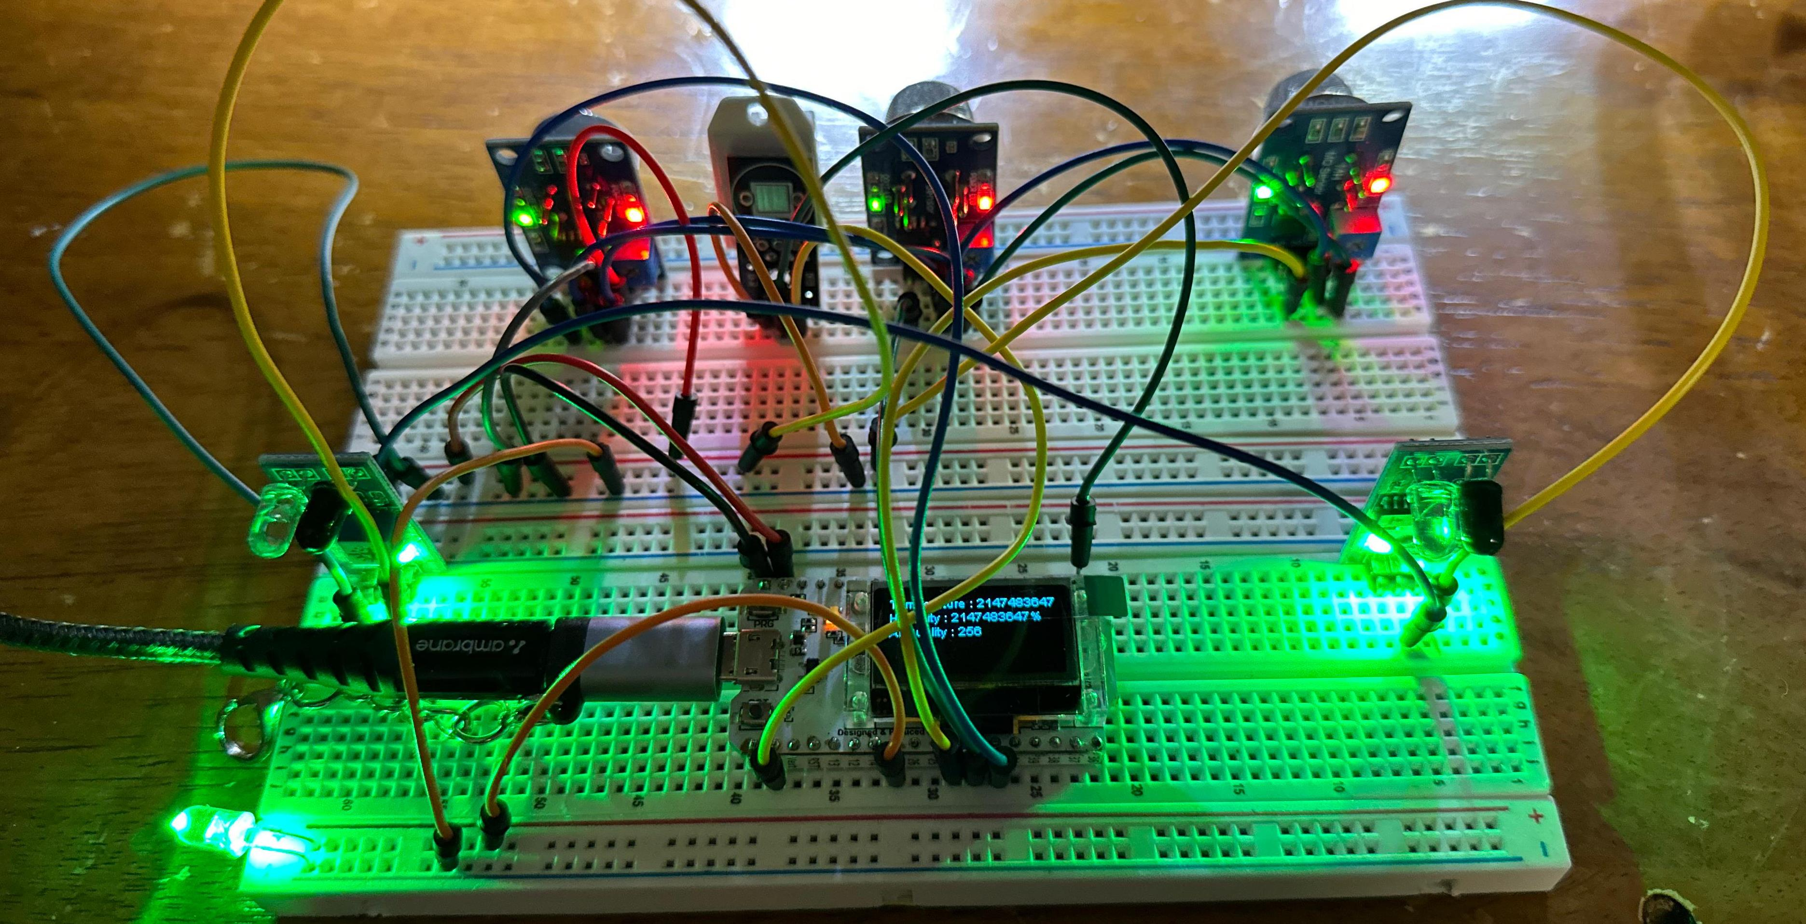
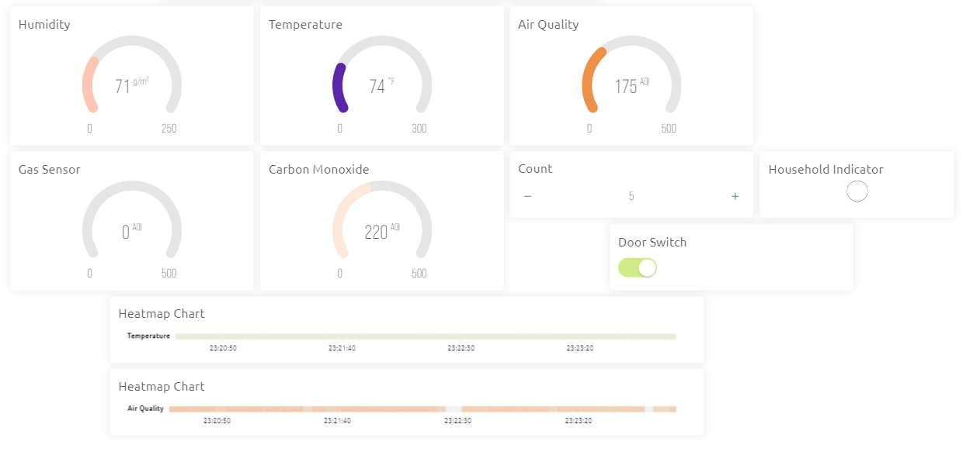


Home Safety Monitoring using ESP32
Bharath Kumar Pulindram, Padmanabha Reddy Kottam, Hari Kiran Reddy Muthyala, Sai Navya Gundeboyina,
Vasanthi Reddy Gadireddy, Bhavana Ravi Chandran, Yasaswini Allaparthi
Advisor: Dr. Sejun Song, University of Missouri, Kansas City
Monitoring temperature, humidity, gas quality, air quality and the current household helps ensure a comfortable and healthy indoor environment. Poor air quality can lead to various health issues such as respiratory problems, allergies, and asthma. By monitoring temperature and humidity levels, you can optimize energy consumption by adjusting heating, ventilation, and air conditioning (HVAC) systems accordingly. By monitoring household count, we can adjust the air conditioning temperature automatically, thereby saving electricity. It is unsafe if more than the required people are crowded in an environment. Hence our project checks and provide safety measurements.
MOTIVATION
Hardware
Source Code
Circuit Diagram
ESP32
MQ5
MQ2
MQ135
DHT 22
IR Sensors
LEDs
Jumper Wires
Breadboard
PM5 Sensor
Source code is written to capture data from dht22, mq135, mq2, mq5 sensors, count the household using IR sensors and write data to cloud. Code has wifi and blynk cloud configurations defined as well.
Monitoring Zone
Data
Results
Data is recorded in blynk dashboard using blynk widgets and household controls such as door lock and alarm are visible.
All the metrics are measured by gauges, heat maps are visible in the dashboard, door lock and unlock is visualized based on the household count.
Results
Conclusion
We are able to log the temperature, humidity, air quality, gas quality data, count the number of household moving in and out and lock the door when the threshold amount of people is reached. Based on this data, air conditioning can be altered, check for crowd in rooms, check for air quality during cooking and use safety precautions, provide a healthy environment for people living in an environment.

